Slide 1
ObscuraDrive: Traffic Sign Recognition
Under Real-World Conditions
Saeah Go
CS540, Winter 2025

Slide 2
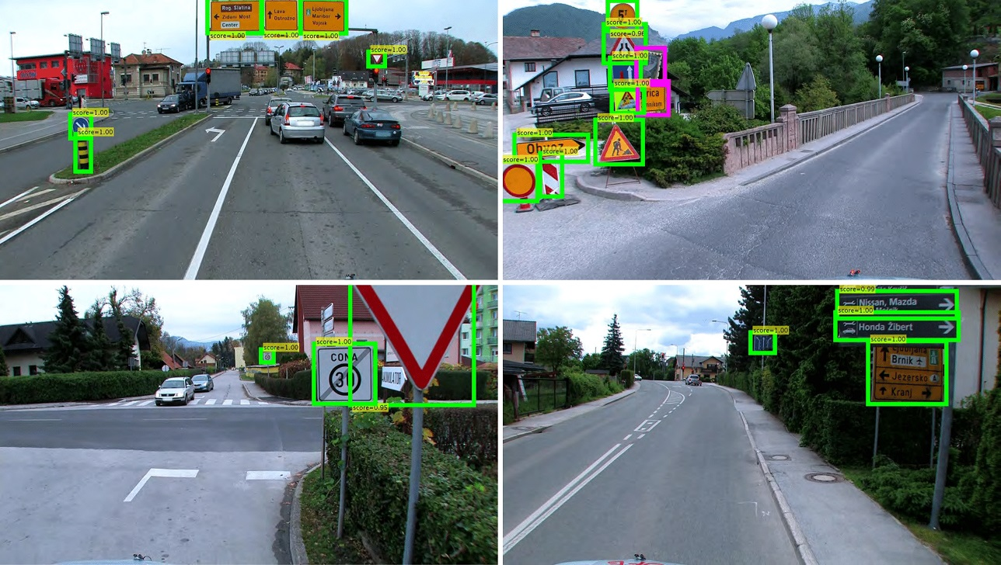
The Problem - Why it is interesting?
What is traffic sign recognition?
A critical component of autonomous driving systems
Vehicles rely on accurate sign recognition to navigate safely, follow speed limits, and make crucial driving decisions
What is the problem?
Current autonomous driving systems struggle in no controlled environments (only work well with specific settings like: clear weather, straight roads, no occlusions)
Real-world conditions include fog, motion blur, and dirt degrade performance
Why it is interesting?
Considering these conditions is needed for autonomous vehicle adoption and safety
Goal: comparing how obscured data affects the performance of the models
Notes:
Interesting part needs to rework - safety issue

Slide 3
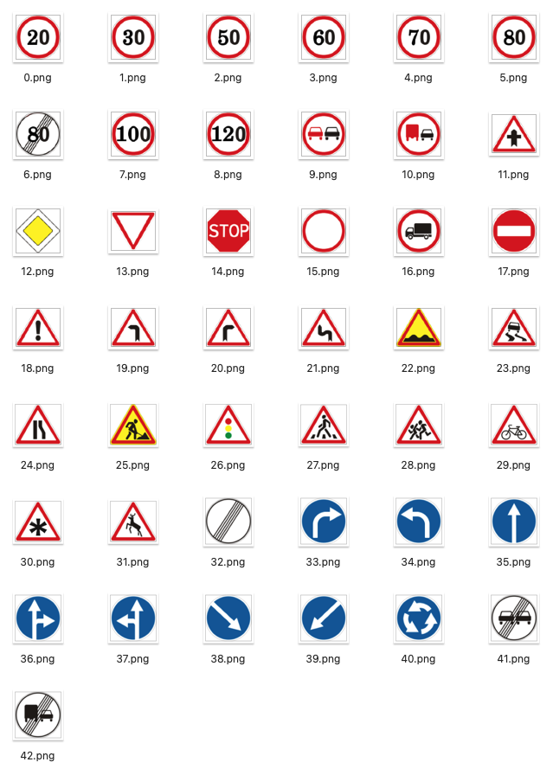
Approach & Methodology
Dataset: German Traffic Sign Recognition Benchmark (GTSRB)
Data Preparation:
Baseline: Original traffic sign images
Obscured
11 cases: blur, sensor noise, fog, object block, motion blur, dirt on the lens, night vision, etc.
Total 33% of sample images obscured (3% x 11 obscuration techniques)
Models:
Used the same data setting/preprocessing for fair comparison
Fully Connected Neural Network (FCNN)
Convolutional Neural Network (CNN)
Transfer Learning (ResNet50, ResNet18)
Evaluation Metrics:
Test accuracy, test loss, and confusion matrix
Notes:
Do I need this?........

Slide 4
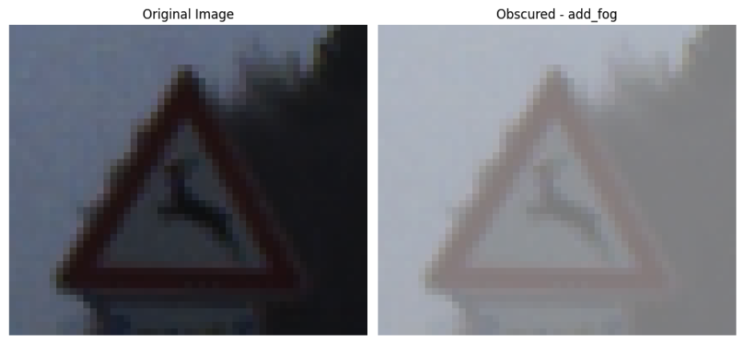
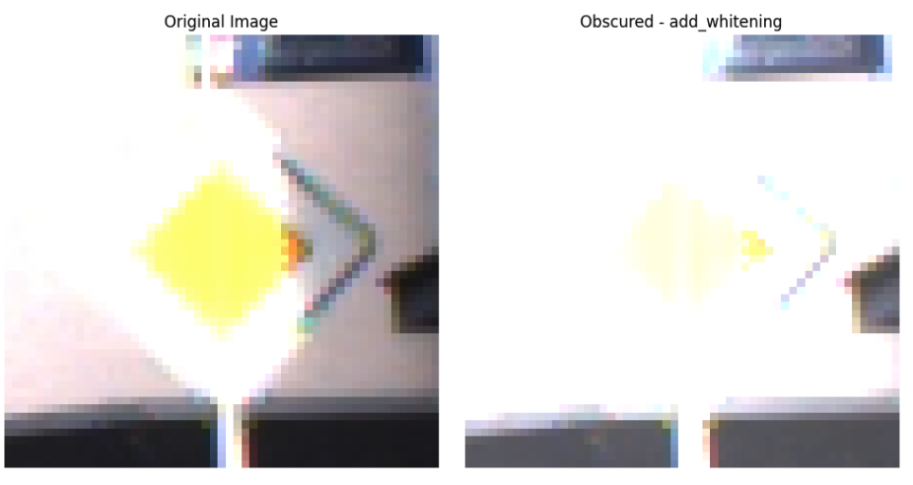
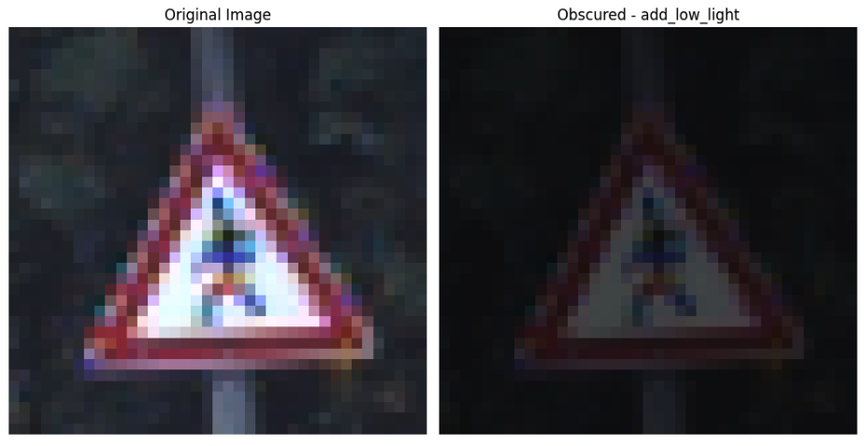
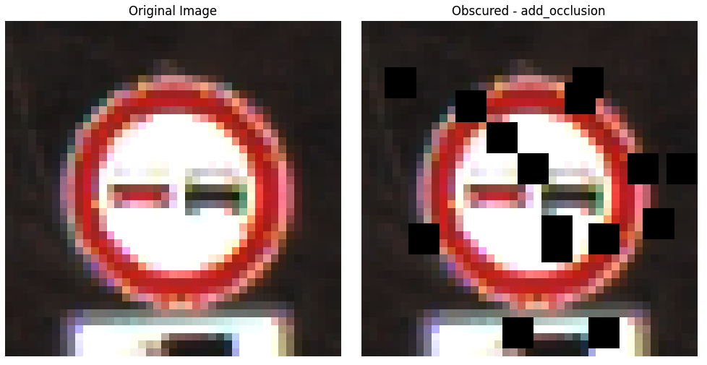
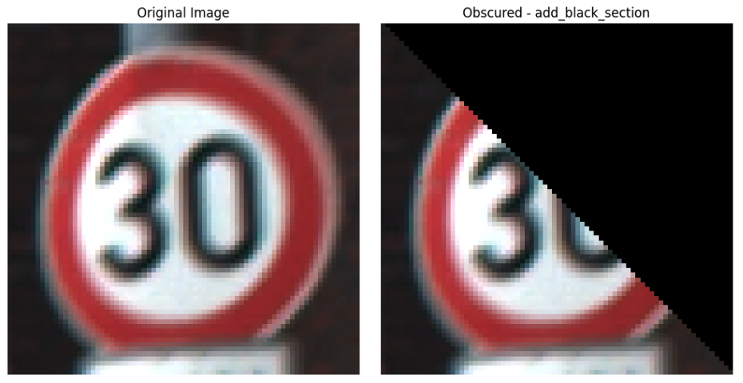
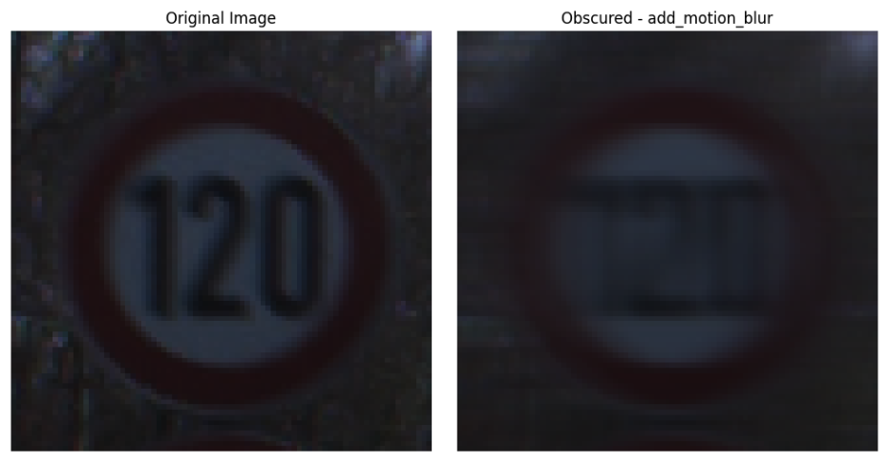
Obscured Image Samples

Slide 5
Project Scope Change
Original Project Scope
Have two dataset (Original/Obscured)
2 layer FCNN
CNN
Compare 4 models
New Project Scope
Have two dataset (Origina/Obscured)
2 layer FCNN
CNN
Transfer Learning (ResNet50)
Transfer Learning (ResNet18)
Compare 8 models
Why changed?
Believe it would be a great opportunity to learn more about transfer learning and it could be a powerful tool for traffic sign classification
Also expected transfer learning will outperform CNN and FCNN due to its robust feature extraction capabilities
Notes:
Should I change to Original goal vs. New goal? And explain why I changed… — And my kernel crashed with ResNet50 + 224x224 resizing, thus I had to change to ResNet18

Slide 6
Hypothesis
Obscured data would degrade model performance due to missing or corrupted features, especially for class 0 to class 9 (speed limit signs)
CNNs would outperform FCNNs, since CNNs are better at extracting image features
ResNet50 would achieve the best performance, as it leverages pre-trained ImageNet features
Notes:
Should I change to Original goal vs. New goal? And explain why I changed…

Slide 7
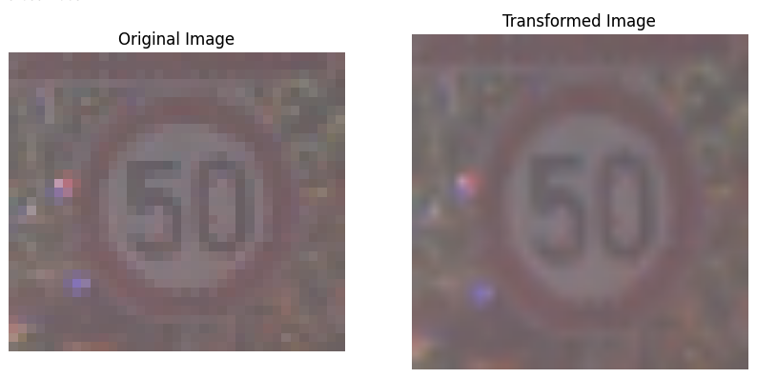
Problem: Image Resizing for TL
Solution:
Original images are 29x30, 30x30 or 32x32 pixels
With ResNet50, I resized the images to 224x224, and session crashed due to computational overload
Reduced ResNet50’s input size to 128x128 to fit my hardware limitations
Also tried ResNet18 with 224x224 resized images - simpler and smaller model than ResNet50 and could handle the resolution better
Notes:
Your Specific Challenges
You can frame your challenges in light of these common issues:
Data Preparation
Creating the obscured dataset and ensuring realistic augmentations (e.g., motion blur, fog).
Generating labels for the obscured data and verifying their accuracy.
Model Tuning
Fine-tuning the Transfer Learning model for GTSRB (e.g., finding the optimal learning rate, number of layers to freeze).
Ensuring fair comparison between the three models.
Analyzing Results
Understanding why Transfer Learning worked better (or worse) in certain cases.
Interpreting why models struggled with specific traffic sign classes or obscurations.
Technical Limitations
Training large datasets with limited computational power (e.g., oversampling challenges).

Slide 8
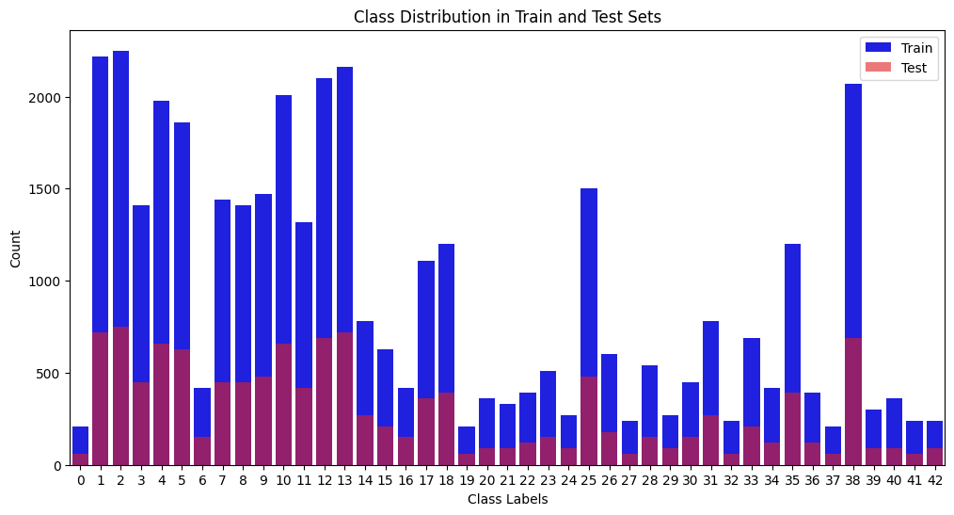
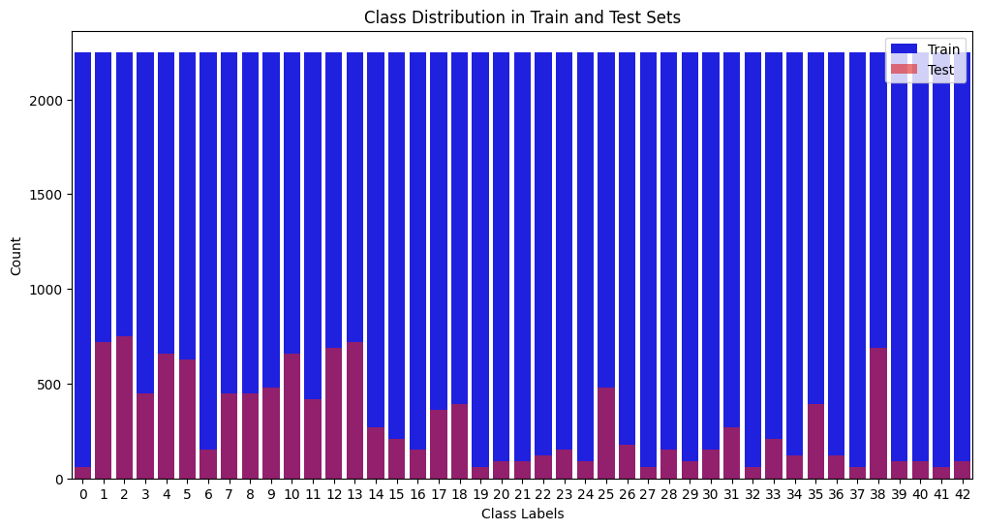
Problem: Class Imbalance & Overfitting
Solution: Class Imbalance & Overfitting
Class Imbalance: Originally had an uneven distribution of traffic signs
Overfitting: Extreme overfitting observed after initial training. The model performed well on the training set but poorly on the test set, suggesting that it was memorizing the data rather than learning general features.
Oversampling (Initial Attempt): Used oversampling to replicate minority class samples
Enhanced with Data Augmentation: But overfitting persisted as the model was still seeing the same images repeatedly. Used augmentation to increase data variability
Notes:
Your Specific Challenges
You can frame your challenges in light of these common issues:
Data Preparation
Creating the obscured dataset and ensuring realistic augmentations (e.g., motion blur, fog).
Generating labels for the obscured data and verifying their accuracy.
Model Tuning
Fine-tuning the Transfer Learning model for GTSRB (e.g., finding the optimal learning rate, number of layers to freeze).
Ensuring fair comparison between the three models.
Analyzing Results
Understanding why Transfer Learning worked better (or worse) in certain cases.
Interpreting why models struggled with specific traffic sign classes or obscurations.
Technical Limitations
Training large datasets with limited computational power (e.g., oversampling challenges).

Slide 9
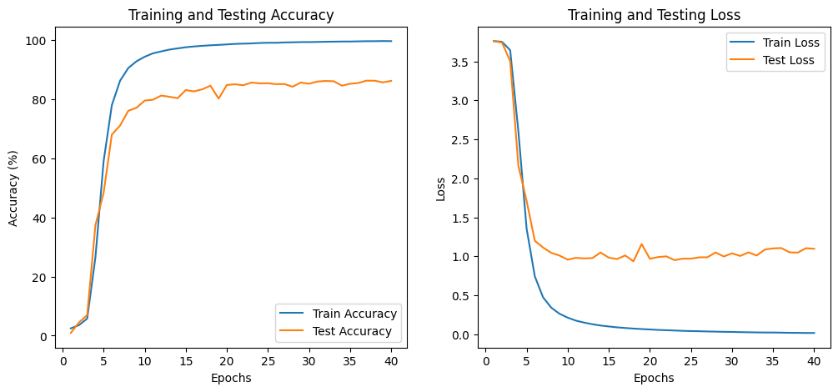
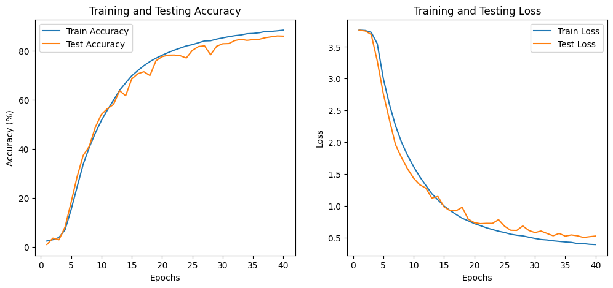
Before Augmentation vs. After Augmentation
After applying data augmentation, a significant improvement in generalization, and the model’s performance on the test set improved. The overfitting issue was reduced, and the model was able to better classify both majority and minority classes.

Slide 10
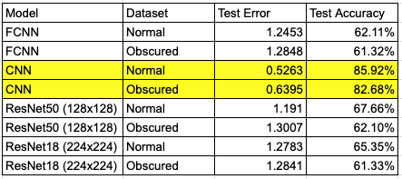
Results
Model Performance on
Normal vs. Obscured Data
FCNN performs poorly overall (highest test error and lowest accuracy for both dataset), and no difference for original vs obscured dataset - does not use convolutional layers, it cannot extract spatial features from images
CNN (30x30) performs best among all models, with 85.92% accuracy on the normal dataset
CNN also generalizes well to the obscured data, with only a small drop (from 85.92% → 82.68%)
CNN is optimized for small, structured images like traffic signs, making it more effective than larger models like ResNet
ResNet50 and 18 underperform compared to CNN
Domain mismatch: ResNet models are pretrained on ImageNet (natural images), so might not be best option
Resizing issues: This might due to resizing artifacts (from 30x30 to 128x128 or 224x224 may create noise) - increasing image resolution without proper tuning does not necessarily improve performance
Too many parameters: ResNet models are over-parameterized for this task and might be overfitting the training data
Notes:
ImageNet - what is it?

Slide 11
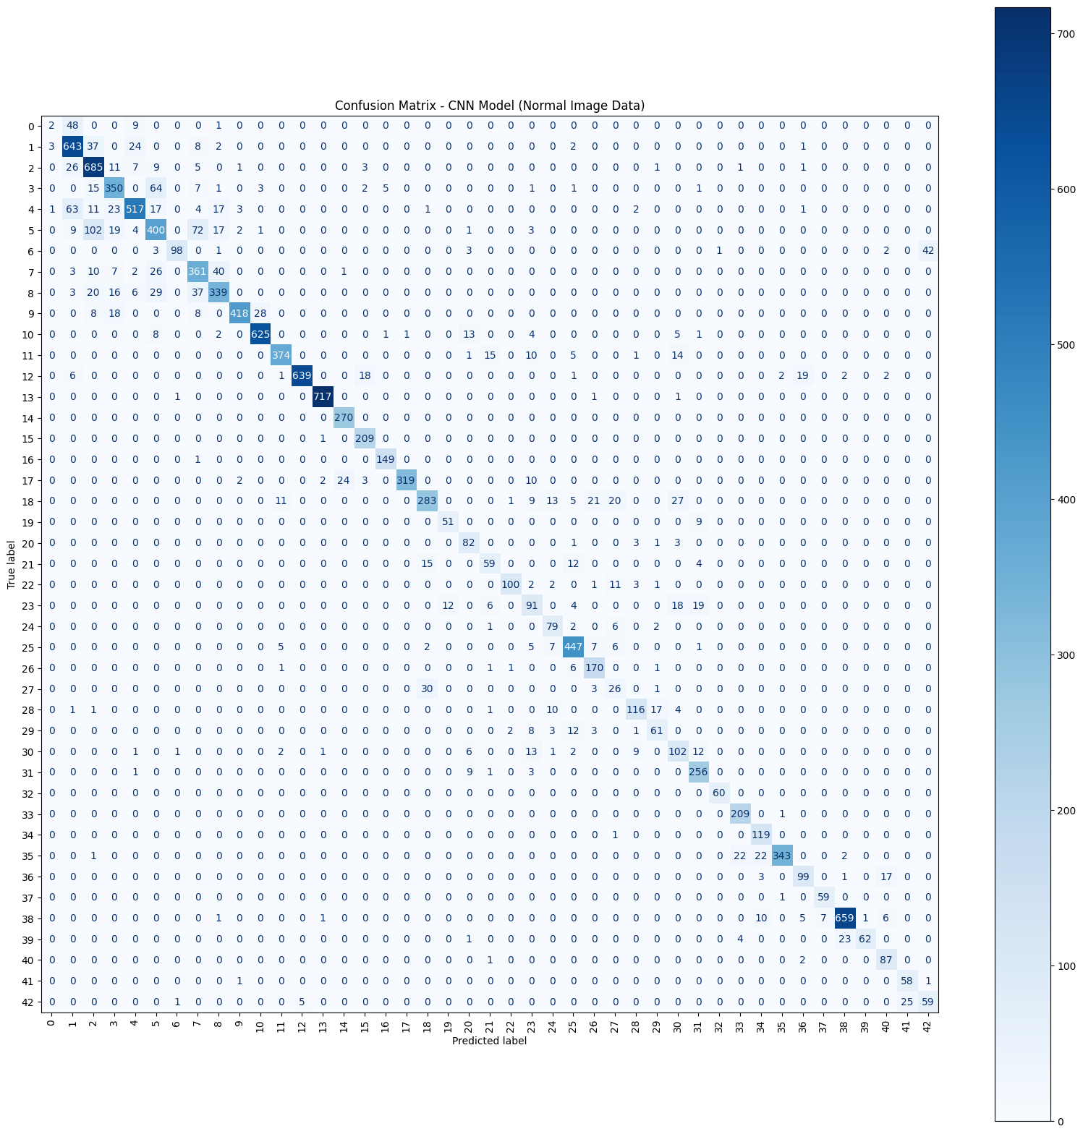
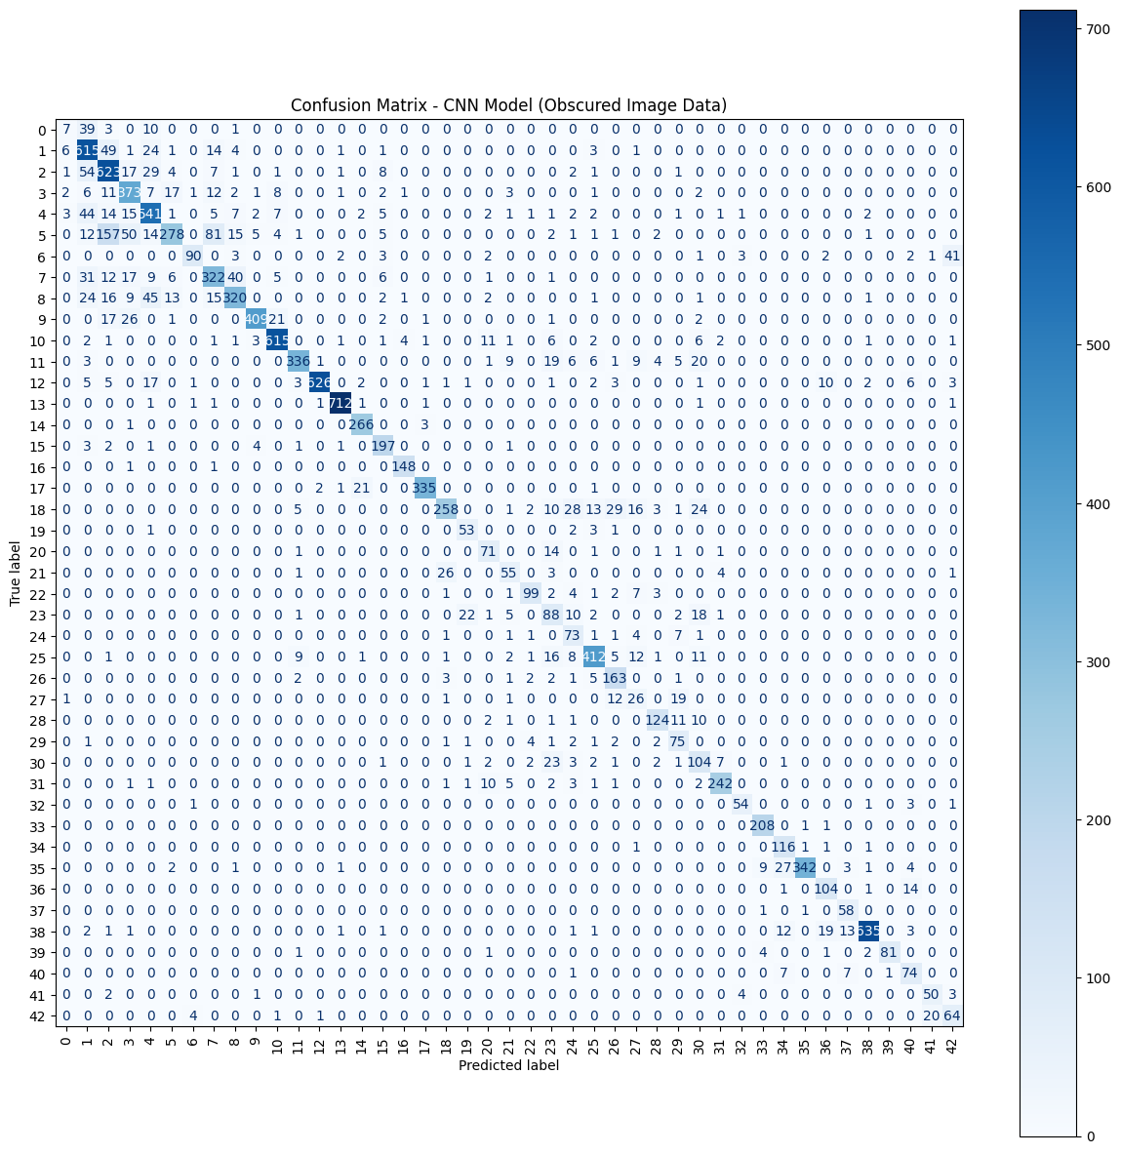
CNN Confusion Matrix Result (Original vs. Obscured)

Slide 12
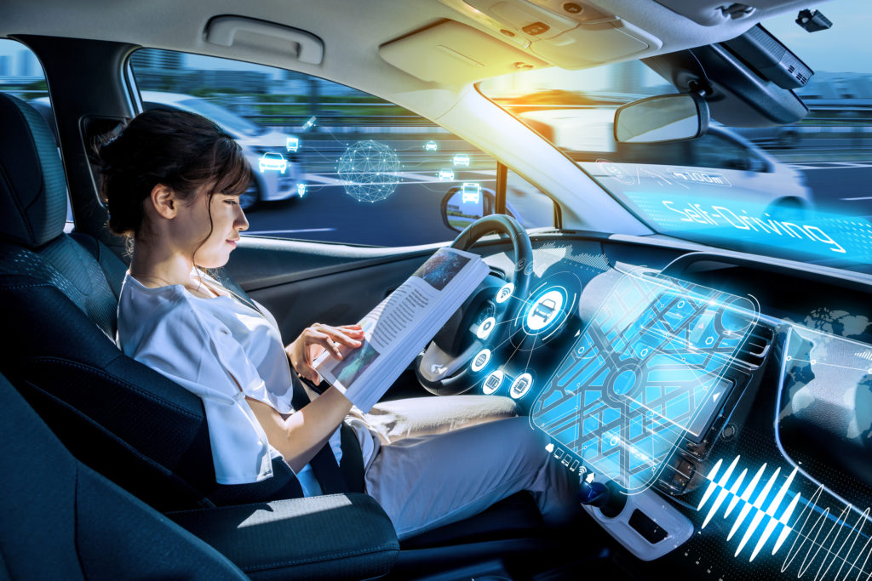
Next Steps
Try a different model like:
Vision Transformers (ViTs) - can capture long-range dependencies in images
ConvNext - more efficient than ResNet
Or a self-driving dataset pretrained model
Train a small, customized CNN with better augmentation to improve generalization
Can models trained on artificially obscured data generalize to real-world occlusions?
Explore the effect of obscuration by changing obscured image percentages
Explore how do different obscuration type affect recognition (blur, weather effects, dirt, etc)
Investigate whether human perception aligns with model errors

Slide 13
Thank you

Slide 14
Reference
Traffic Sign Image Data: https://www.kaggle.com/datasets/meowmeowmeowmeowmeow/gtsrb-german-traffic-sign
https://www.youtube.com/watch?v=SpCCCFcxzlU
https://innovationatwork.ieee.org/autonomous-vehicles-for-today-and-for-the-future/
https://ieeexplore.ieee.org/document/6909583
https://www.isca-archive.org/odyssey_2018/zhang18_odyssey.pdf

Slide 15
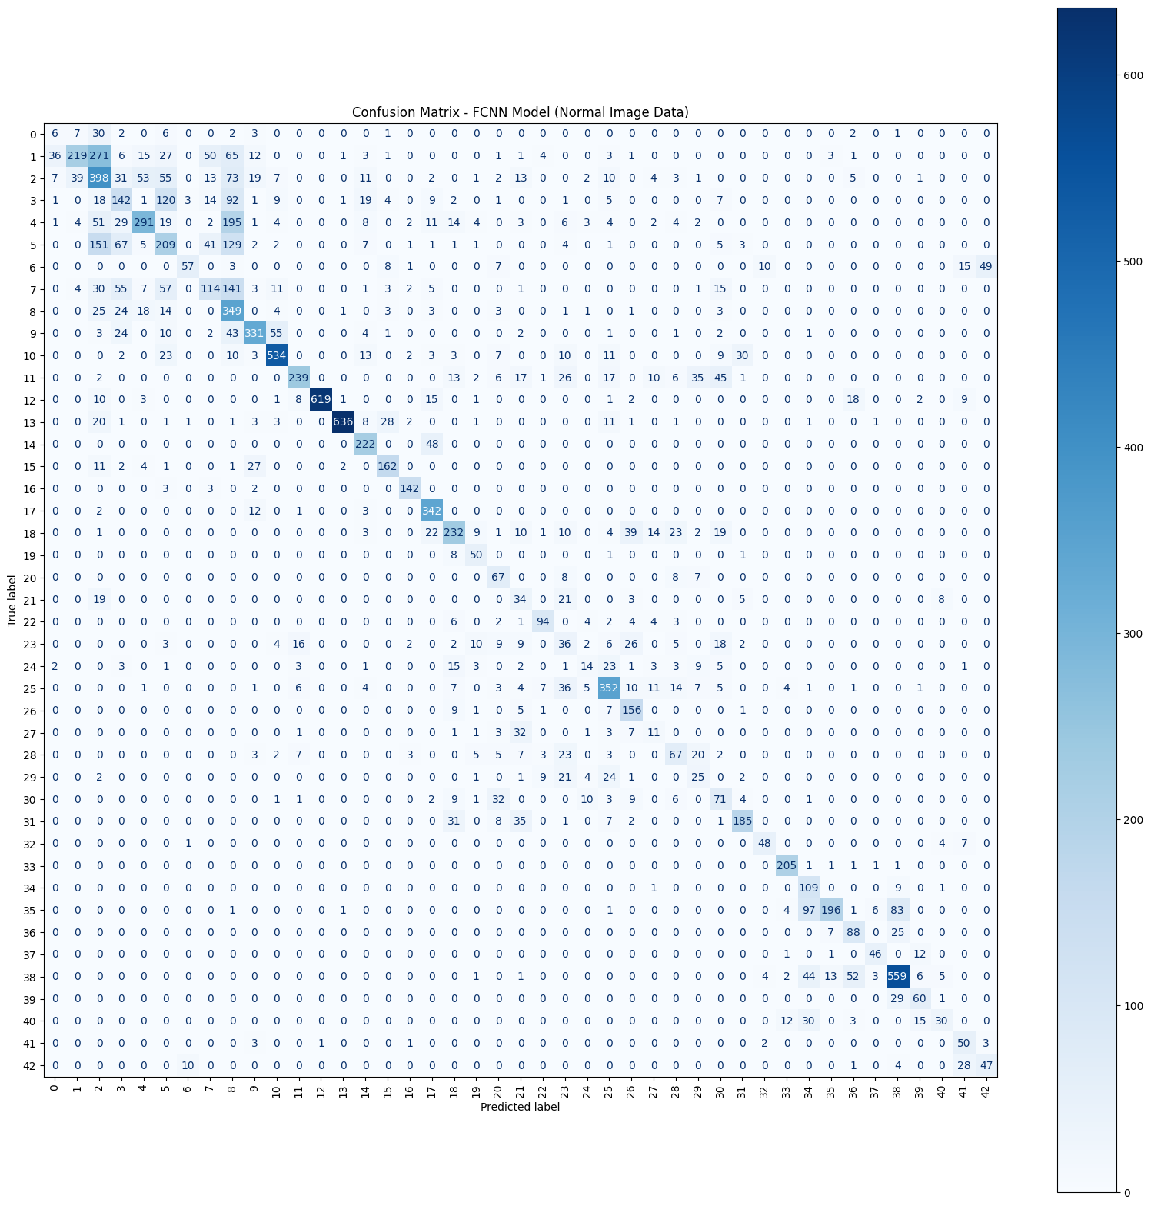
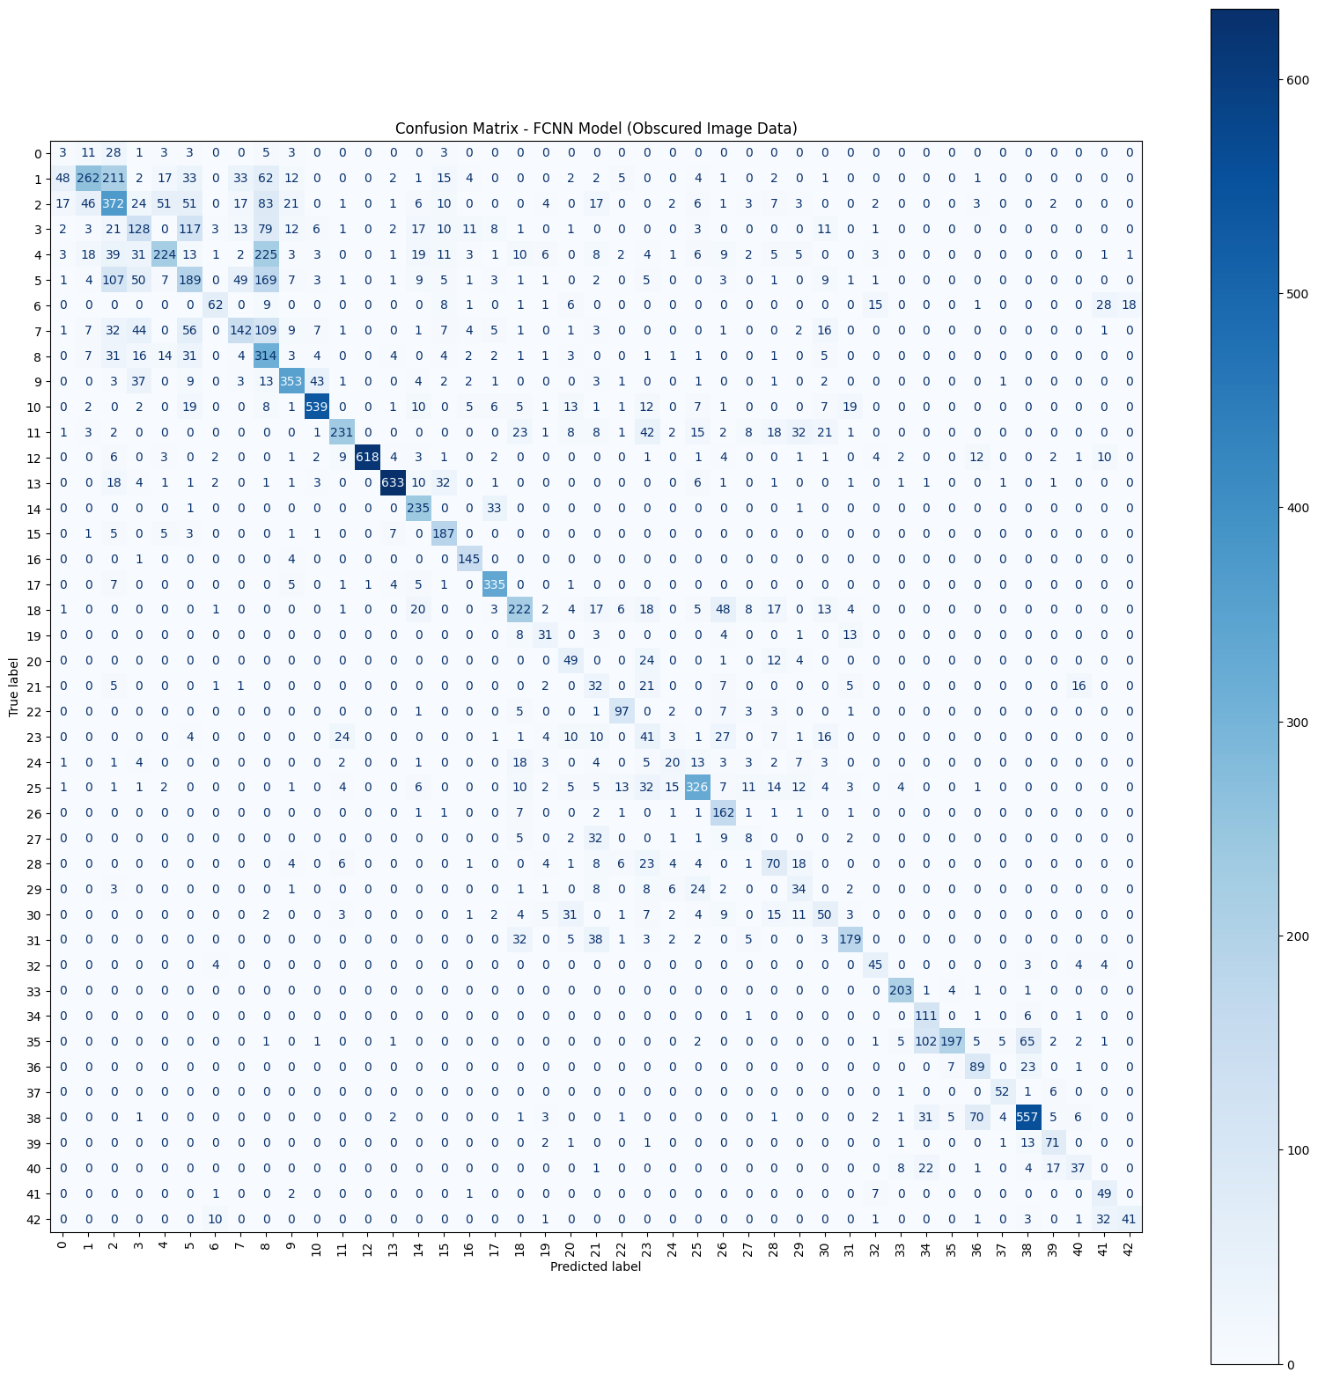
FCNN Confusion Matrix Result (Original vs. Obscured)
Left is with original dataset, right is with obscured dataset

Slide 16
CNN Confusion Matrix Result (Original vs. Obscured)
Left is with original dataset, right is with obscured dataset

Slide 17
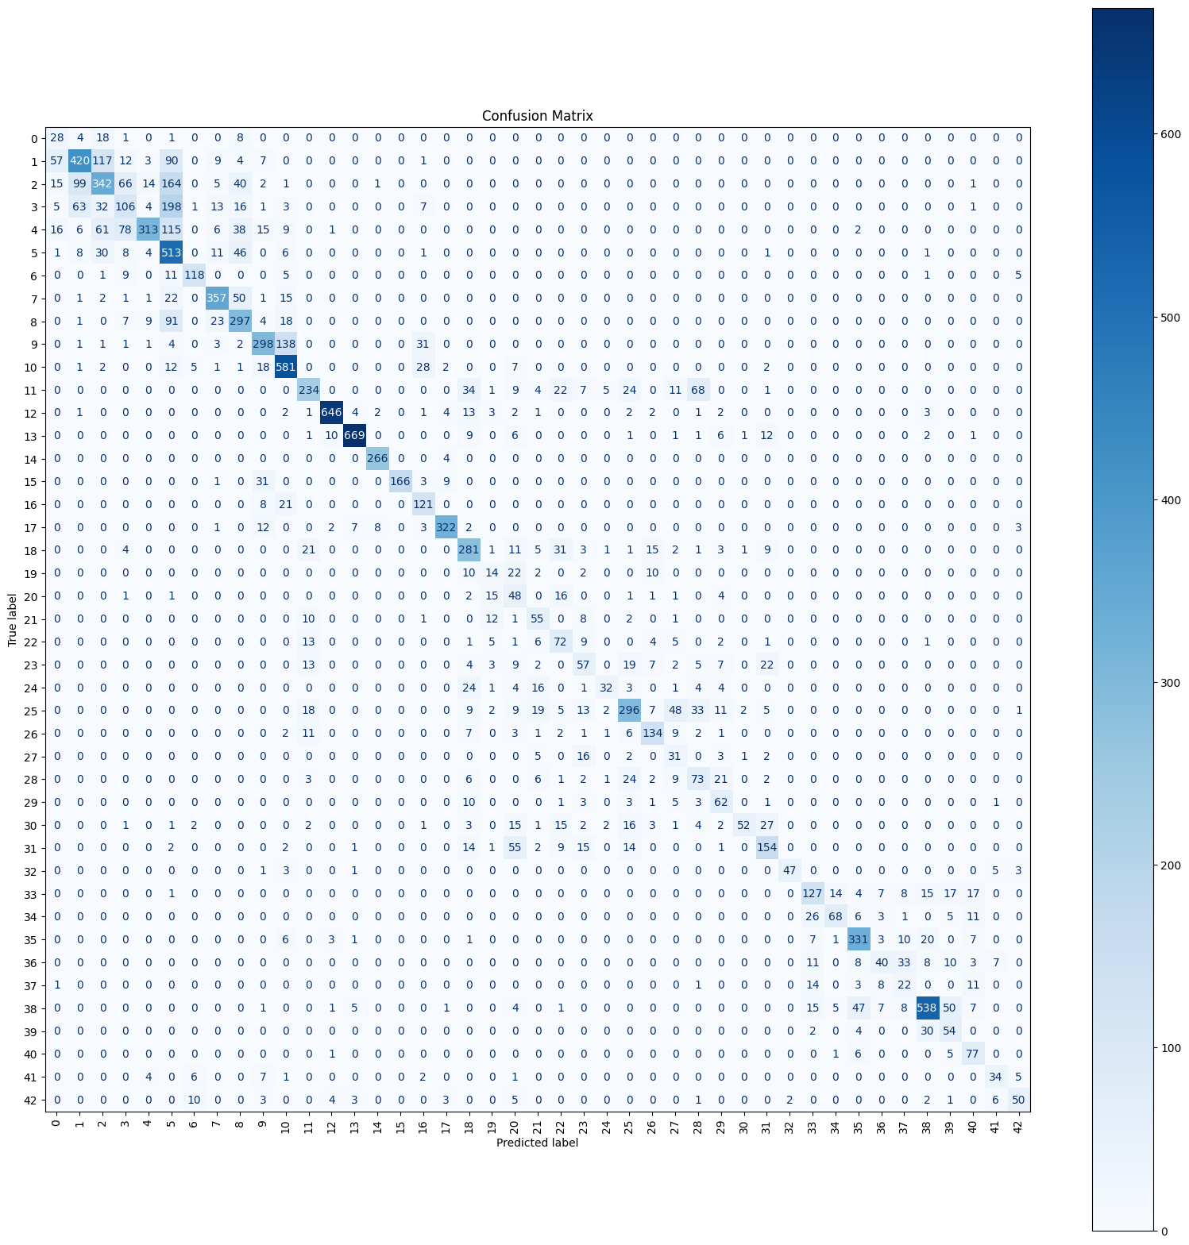
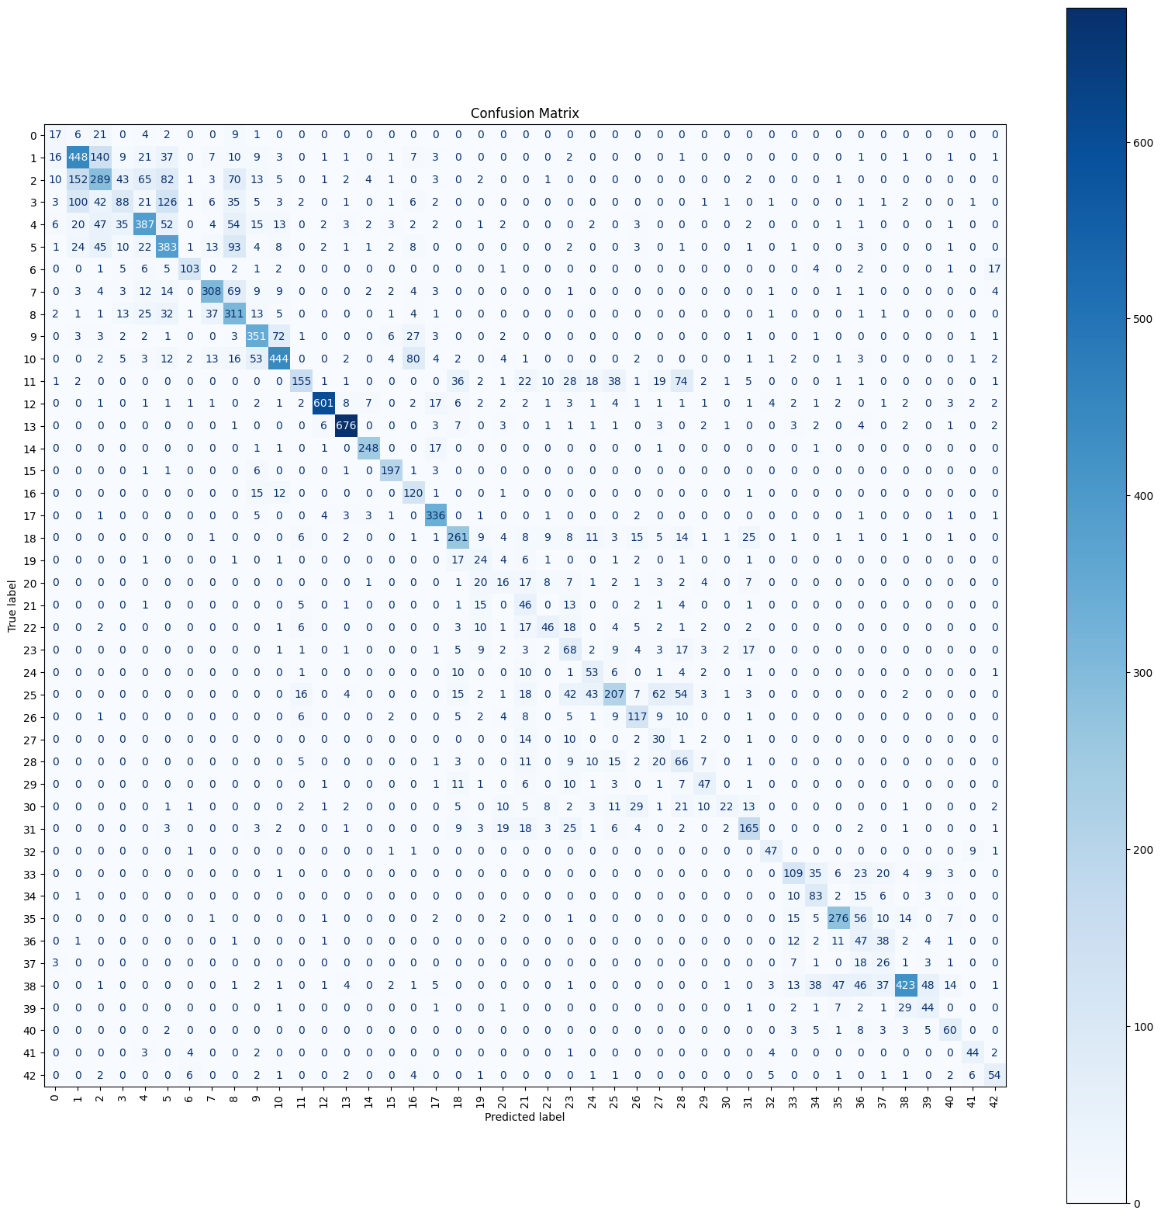
ResNet50 Confusion Matrix Result (Original vs. Obscured)
Left is with original dataset, right is with obscured dataset

Slide 18
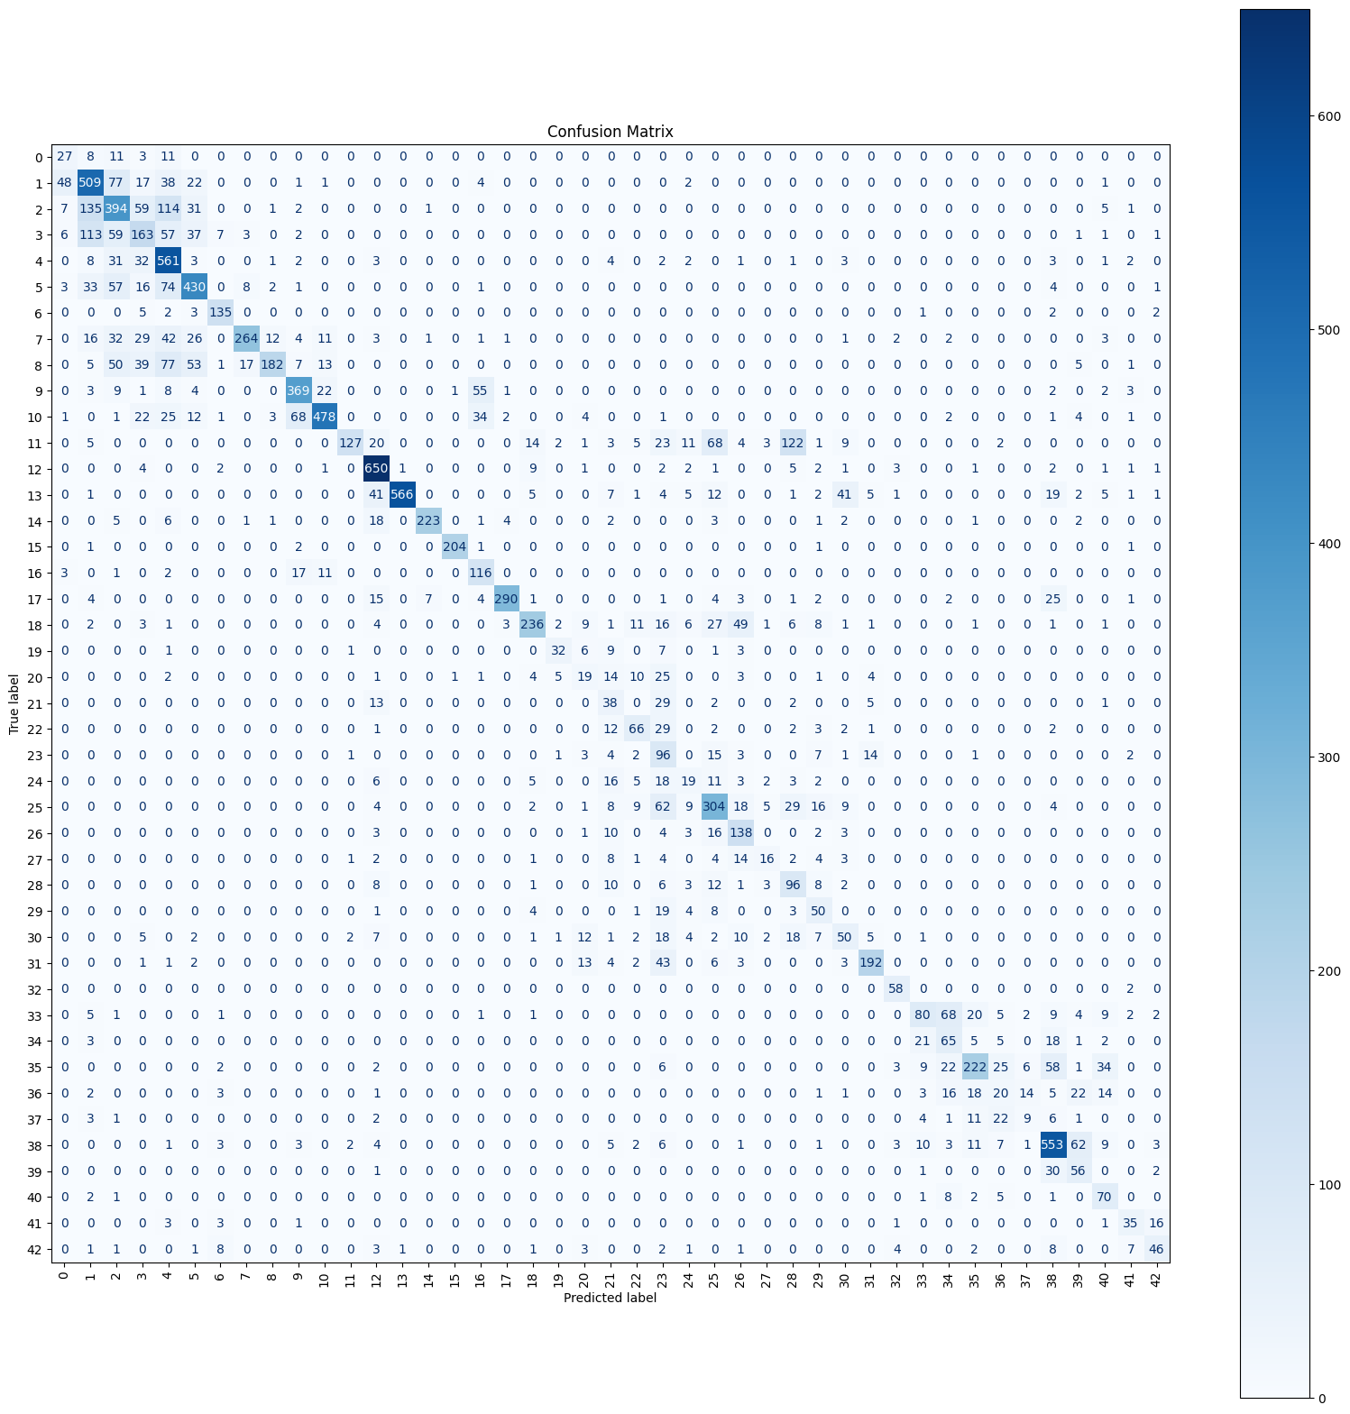
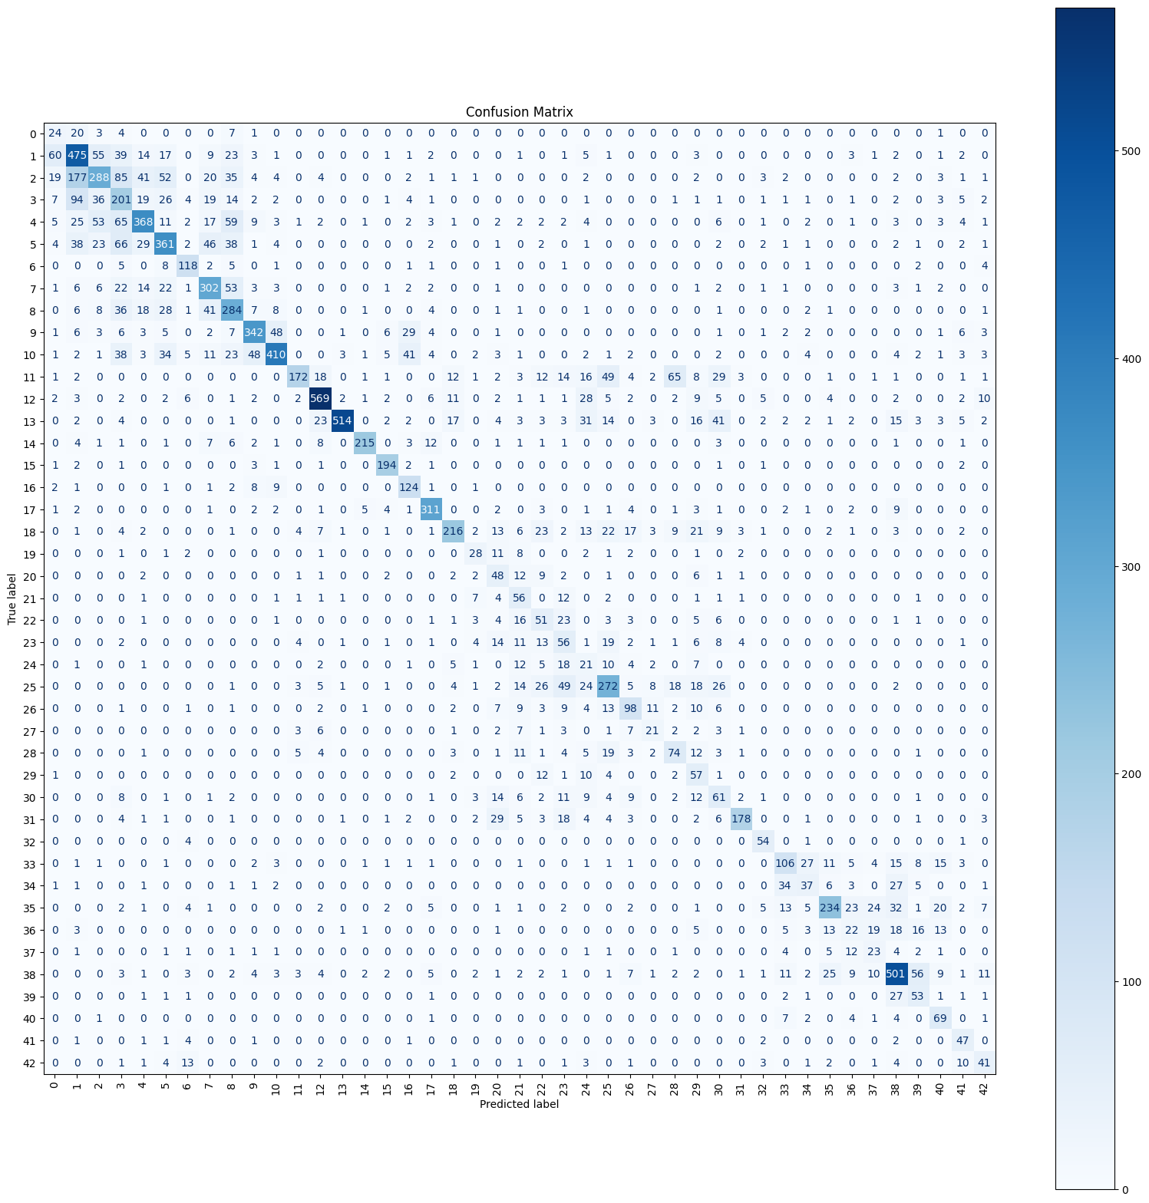
ResNet18 Confusion Matrix Result (Original vs. Obscured)
Left is with original dataset, right is with obscured dataset

